Slide 1

Cloud Computing

Slide 2
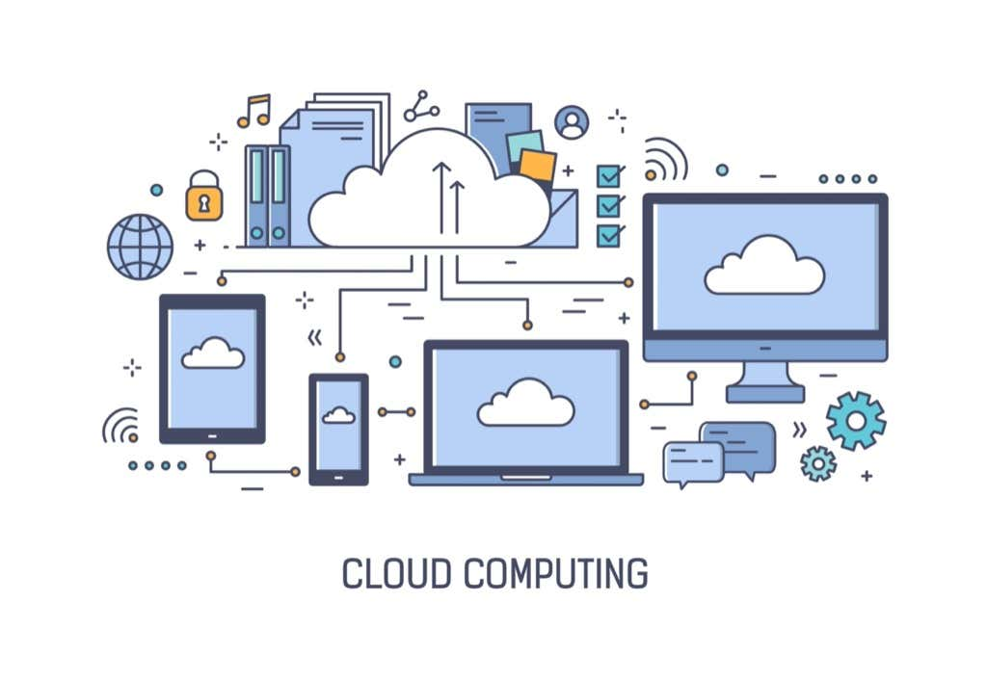

Slide 3
What is Cloud Computing?
• Definition: Cloud computing refers to the delivery of computing services over the internet ('the cloud'), including servers, storage, databases, networking, software, analytics, and more.
• Key Idea: Instead of owning physical hardware and data centers, users access resources on-demand and pay for what they use.
"Cloud computing is a paradigm for enabling network access to a scalable and elastic pool of shareable physical or virtual resources with self-service provisioning and administration on-demand," according to ISO.^{[1]}

Slide 4
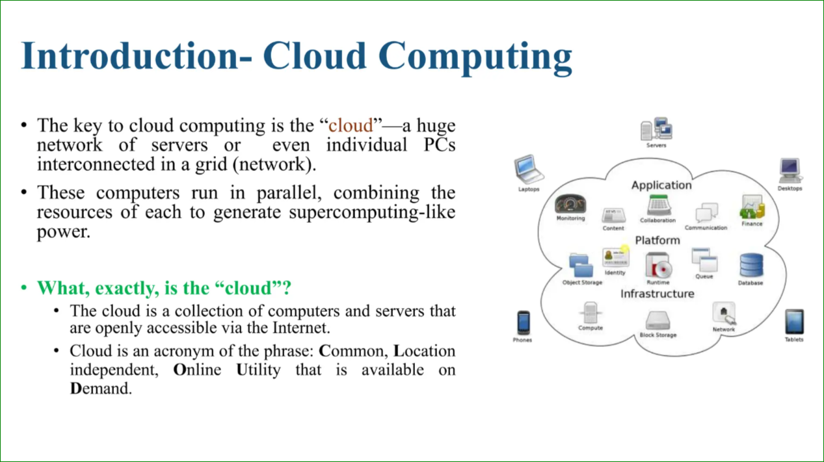

Slide 5
Another Definition:
Cloud computing is defined as the use of hosted services, such as data storage, servers, databases, networking, and software over the internet. Since cloud computing began, the world has witnessed an explosion of cloud-based applications and services in IT, which continue to expand.
Almost every application we use resides on the cloud, helping us save storage space, expenses, and time.

Slide 6
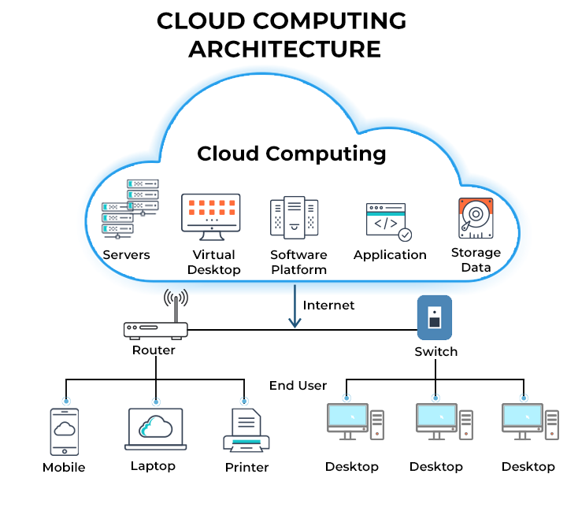

Slide 7
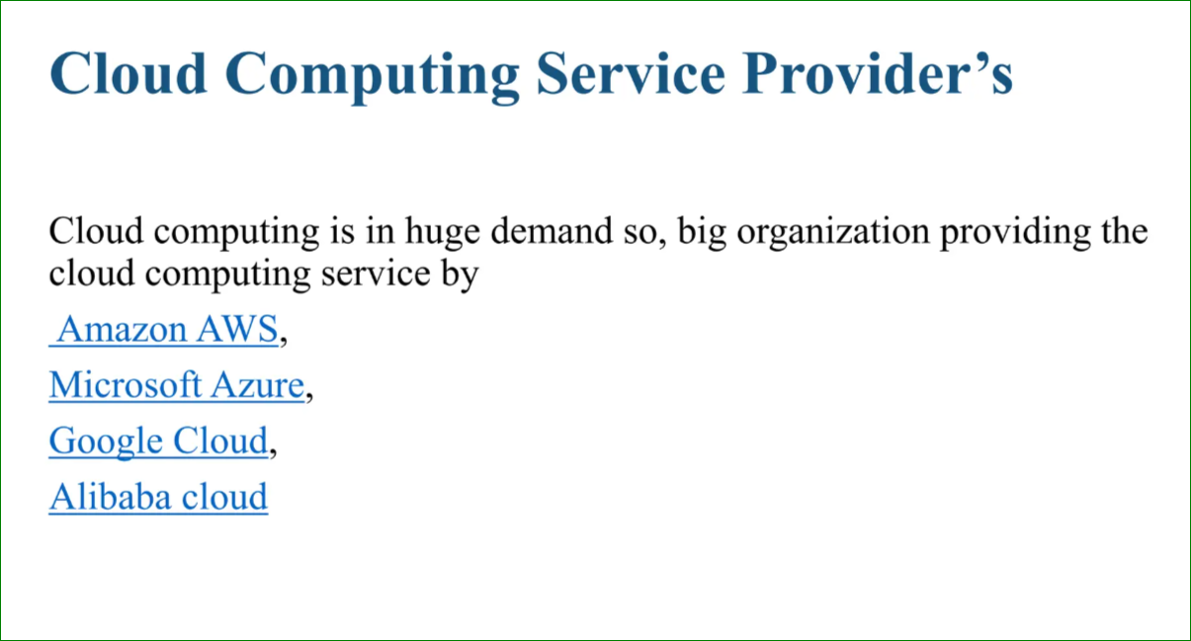

Slide 8
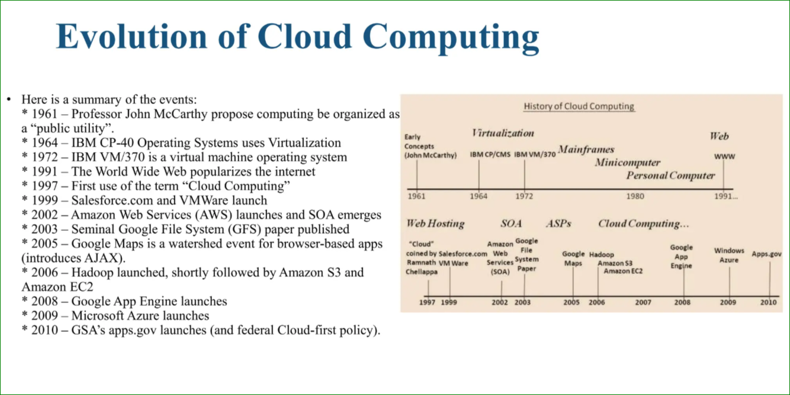

Slide 9
Why It's Called a “Cloud”
Representation in Diagrams: In early network diagrams, the internet was often represented as a fluffy cloud to abstract its complexity. The cloud symbolized an unseen infrastructure delivering data and resources.
2.Abstraction of Complexity: Just like a real cloud obscures what's behind it, cloud computing hides the underlying physical infrastructure from users. People don't see the servers, storage devices, or data centers; they simply access services seamlessly.
3.Omnipresence and Accessibility: Similar to how clouds are everywhere in the sky, cloud computing services are accessible globally, as long as there is an internet connection.

Slide 10
What the Cloud Actually Is
The "cloud" refers to data centers—large facilities filled with physical servers, storage systems, and networking equipment. These data centers are located around the world and owned by companies like Amazon, Microsoft, and Google.
Key Features of the Cloud:
Distributed: Data is spread across multiple locations for reliability.
Virtualized: Resources are allocated and scaled dynamically.
Managed: Providers handle maintenance, security, and updates.

Slide 11
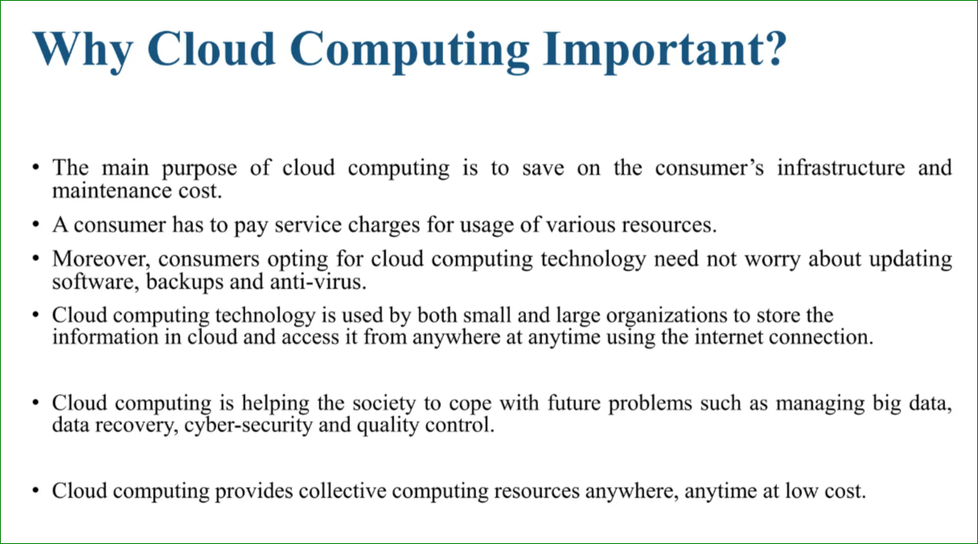

Slide 12
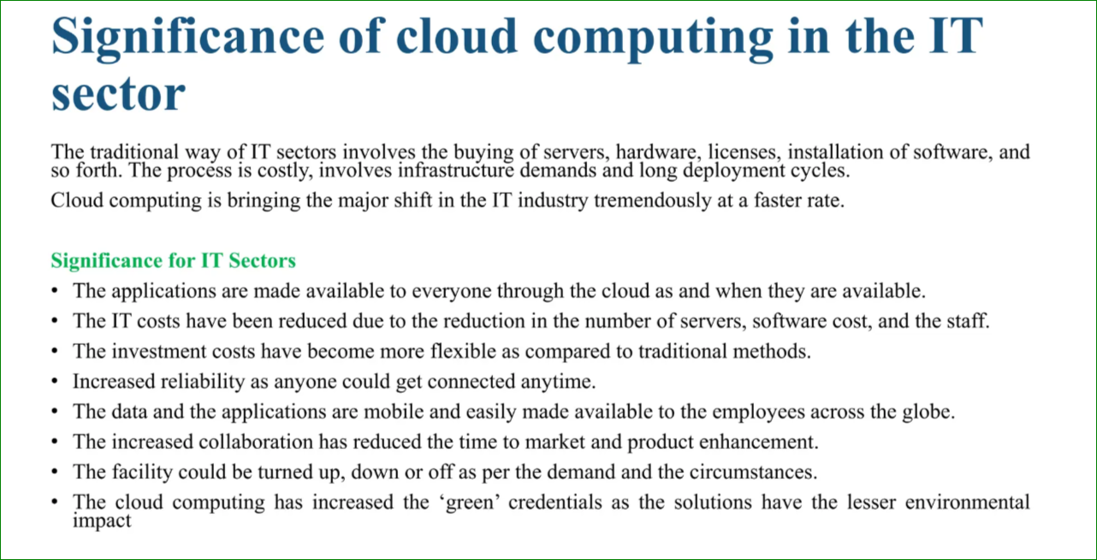

Slide 13
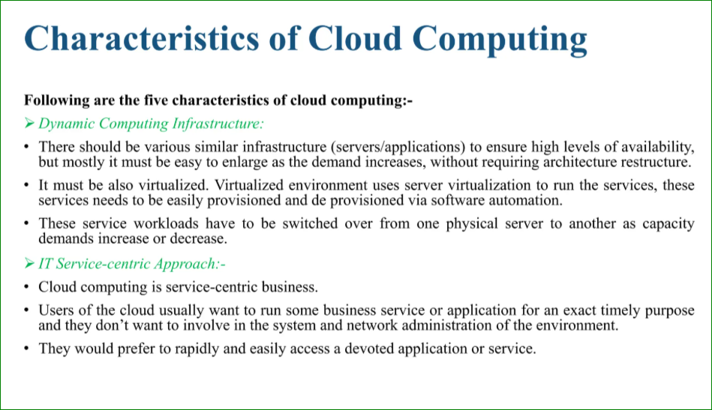

Slide 14
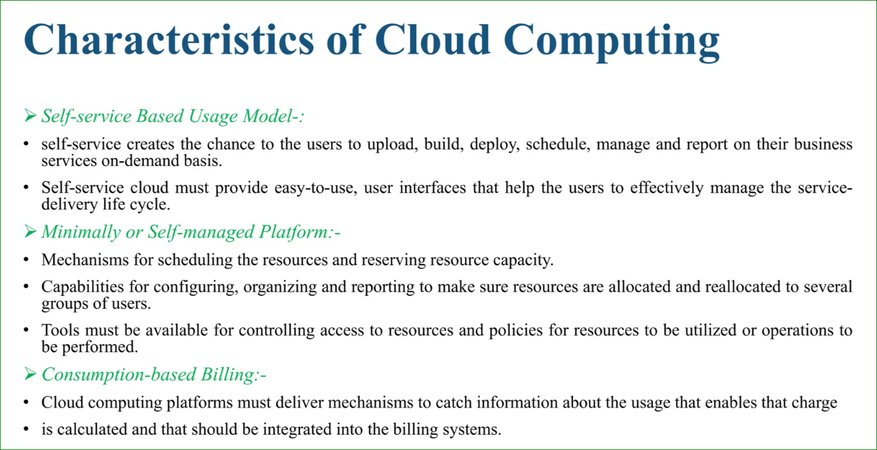

Slide 15
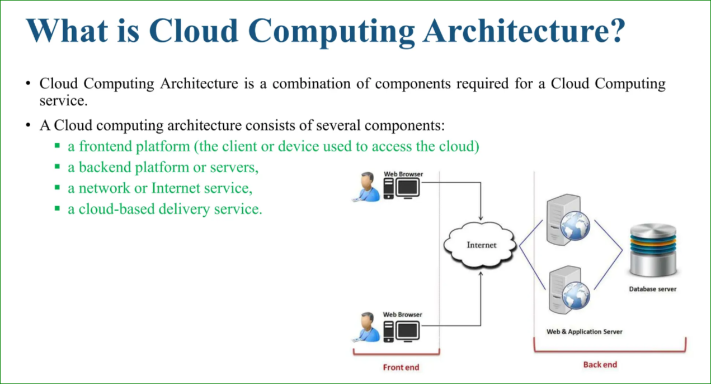

Slide 16
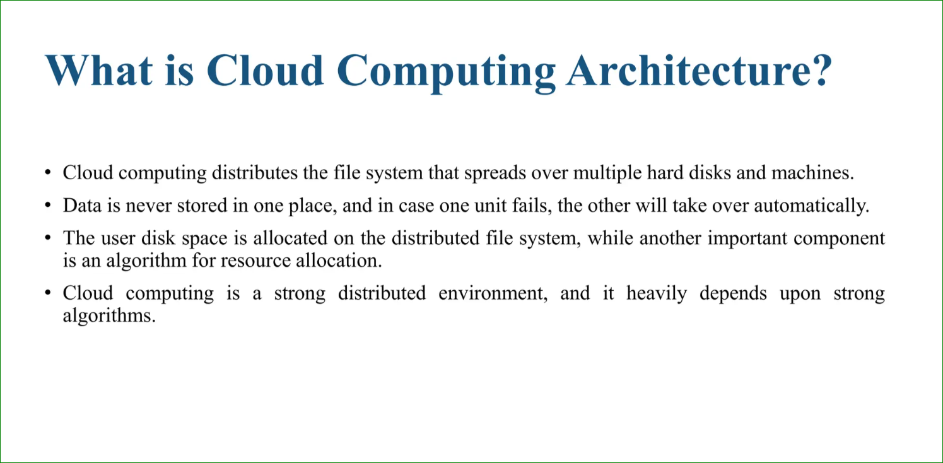

Slide 17
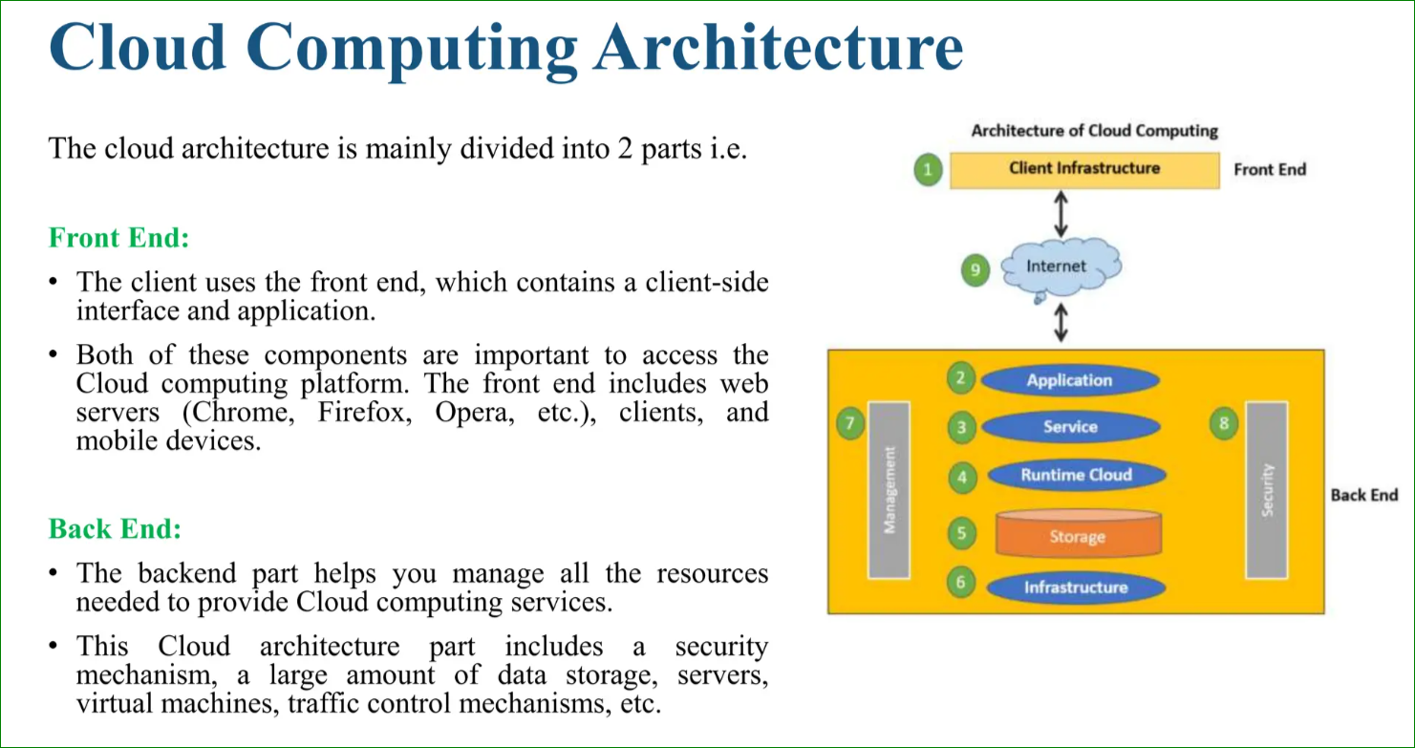

Slide 18
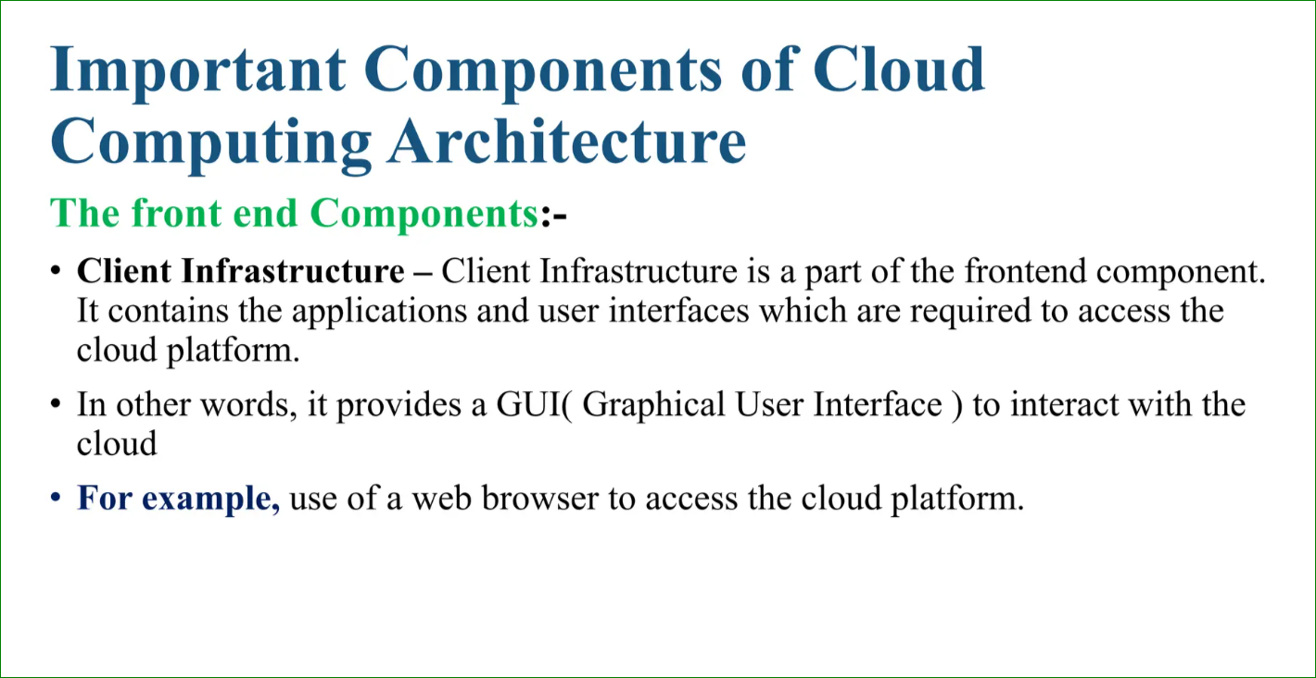

Slide 19
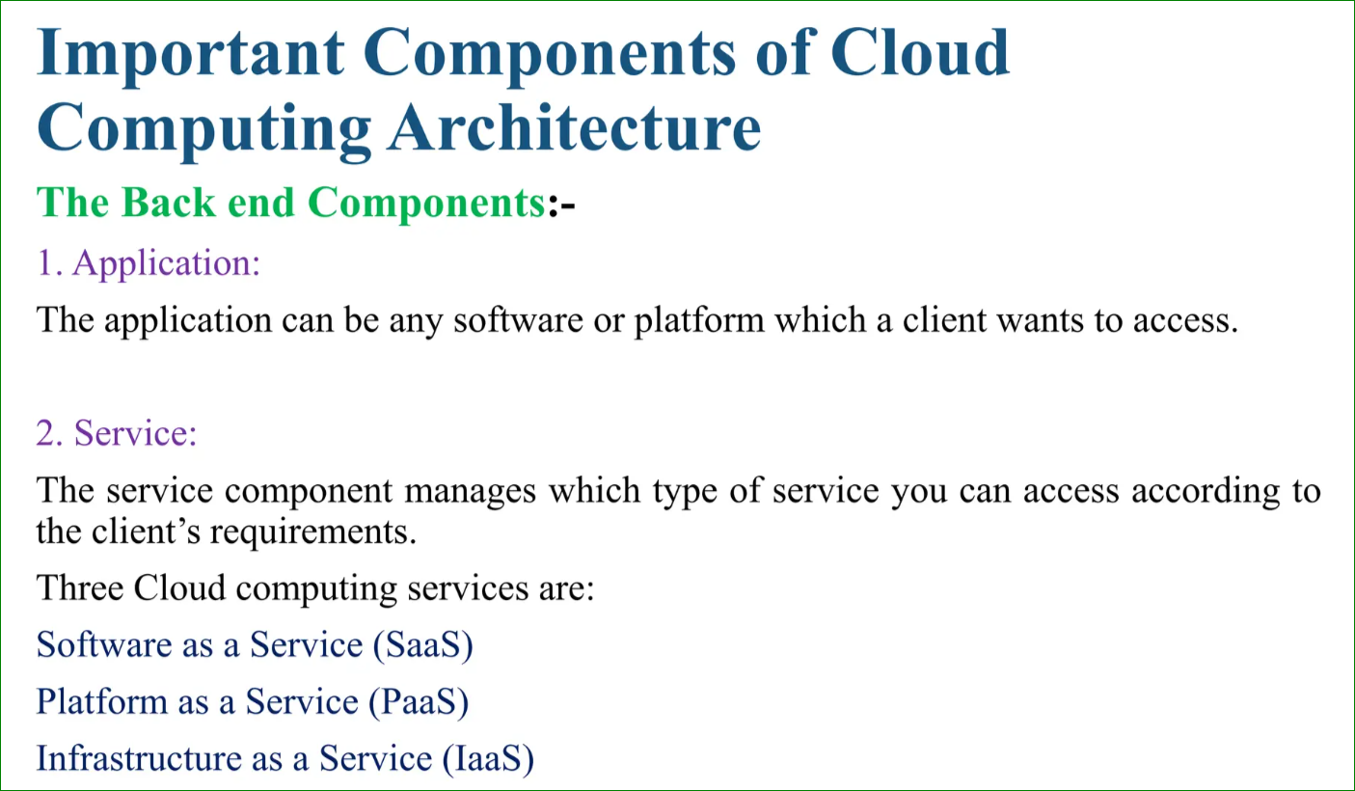

Slide 20
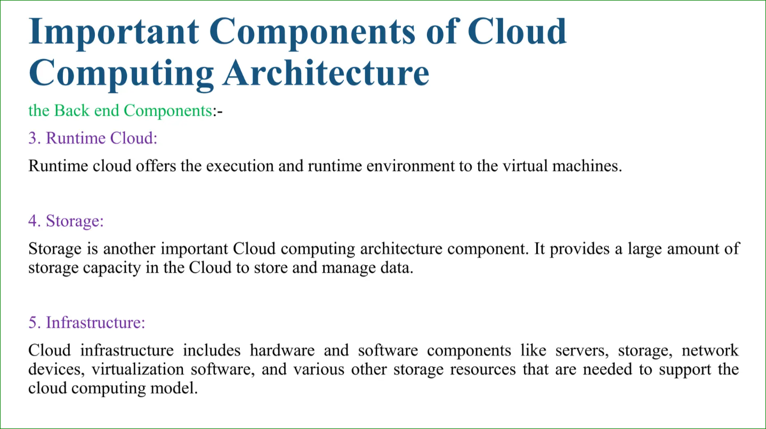

Slide 21
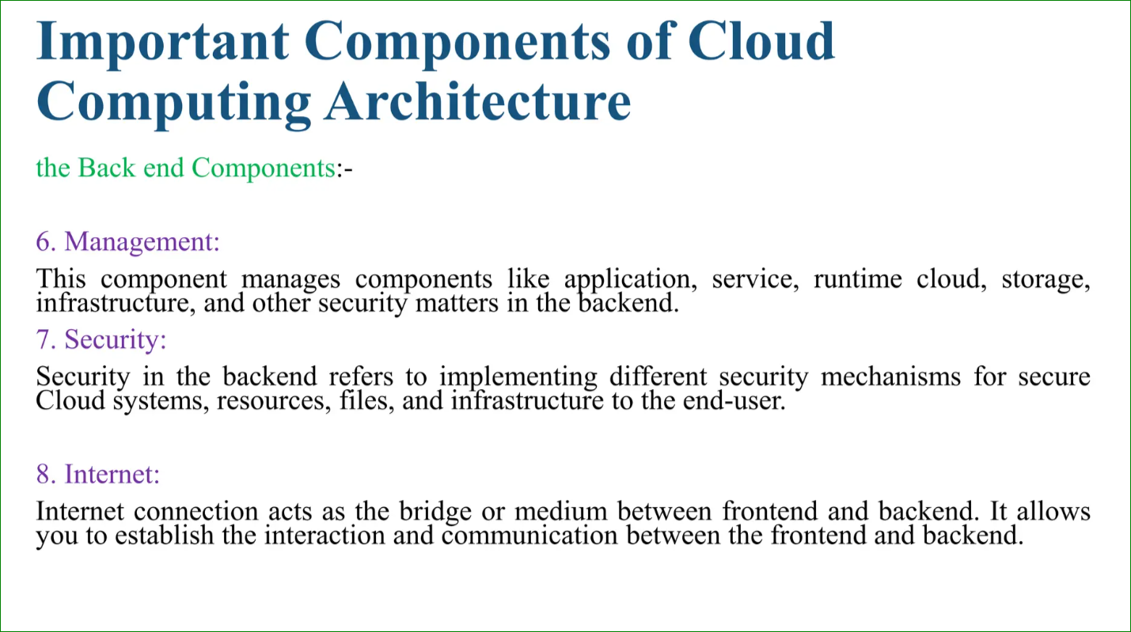

Slide 22
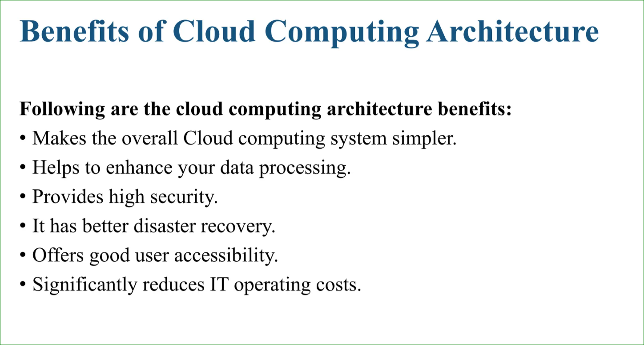

Slide 23
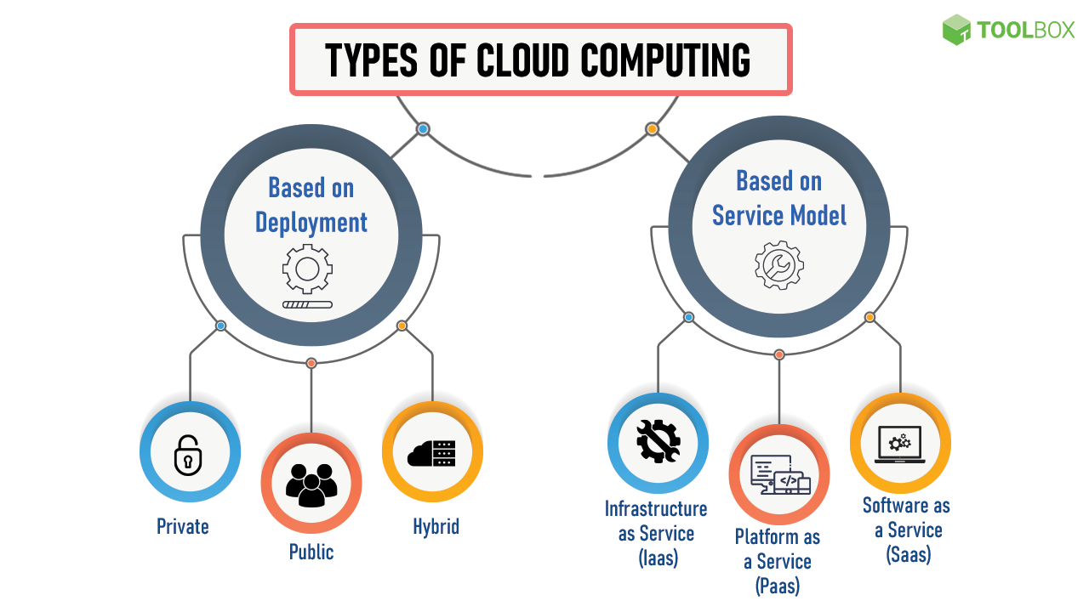

Slide 24
Service Models of Cloud Computing
1. Infrastructure as a Service (IaaS):
- Virtualized computing resources over the internet.
- Example: AWS EC2 for renting virtual servers.
- Example: Startup using AWS EC2 instances.
2. Platform as a Service (PaaS):
- Environment for developers to build, test, and deploy applications.
- Example: Google App Engine.
- Example: Team using Microsoft Azure App Services.
3. Software as a Service (SaaS):
- Software applications delivered over the internet.
- Example: Google Workspace.
- Real-Life Example: Company using Salesforce CRM.

Slide 25
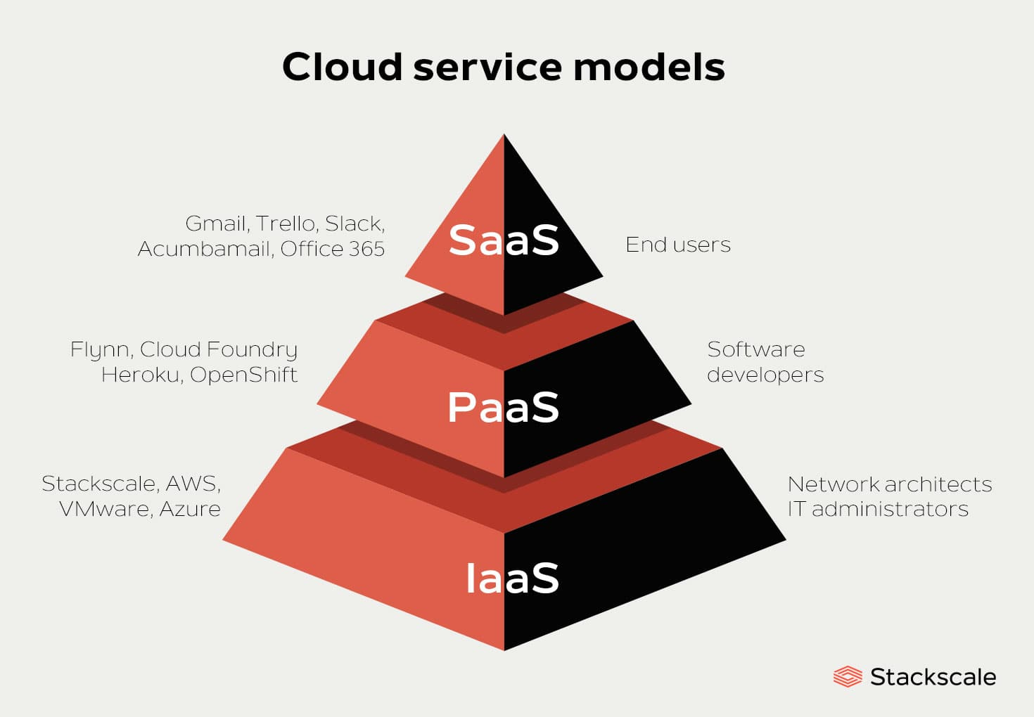

Slide 26
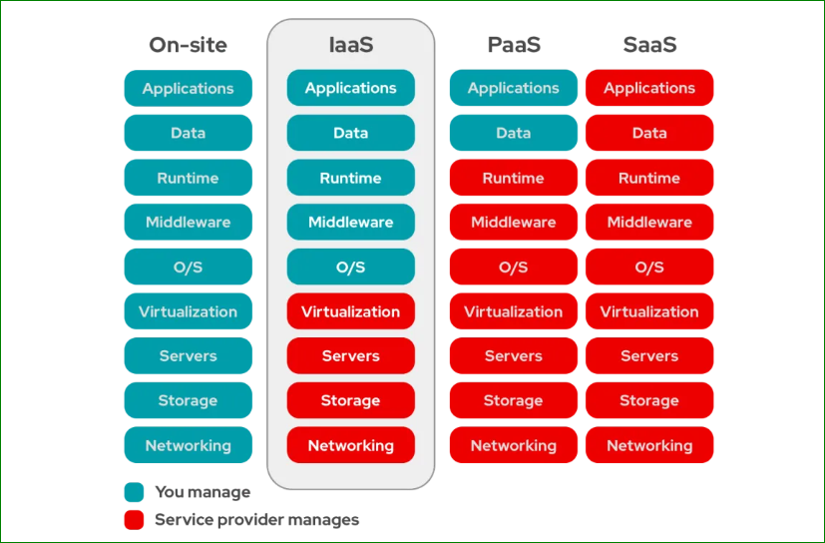

Slide 27
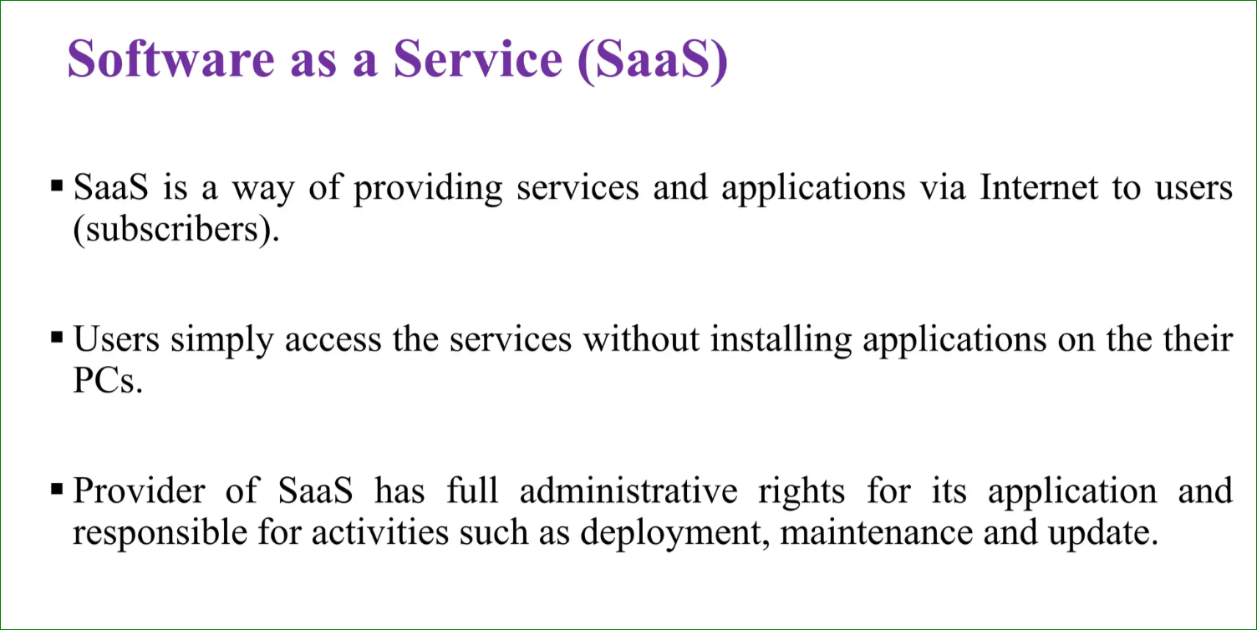

Slide 28
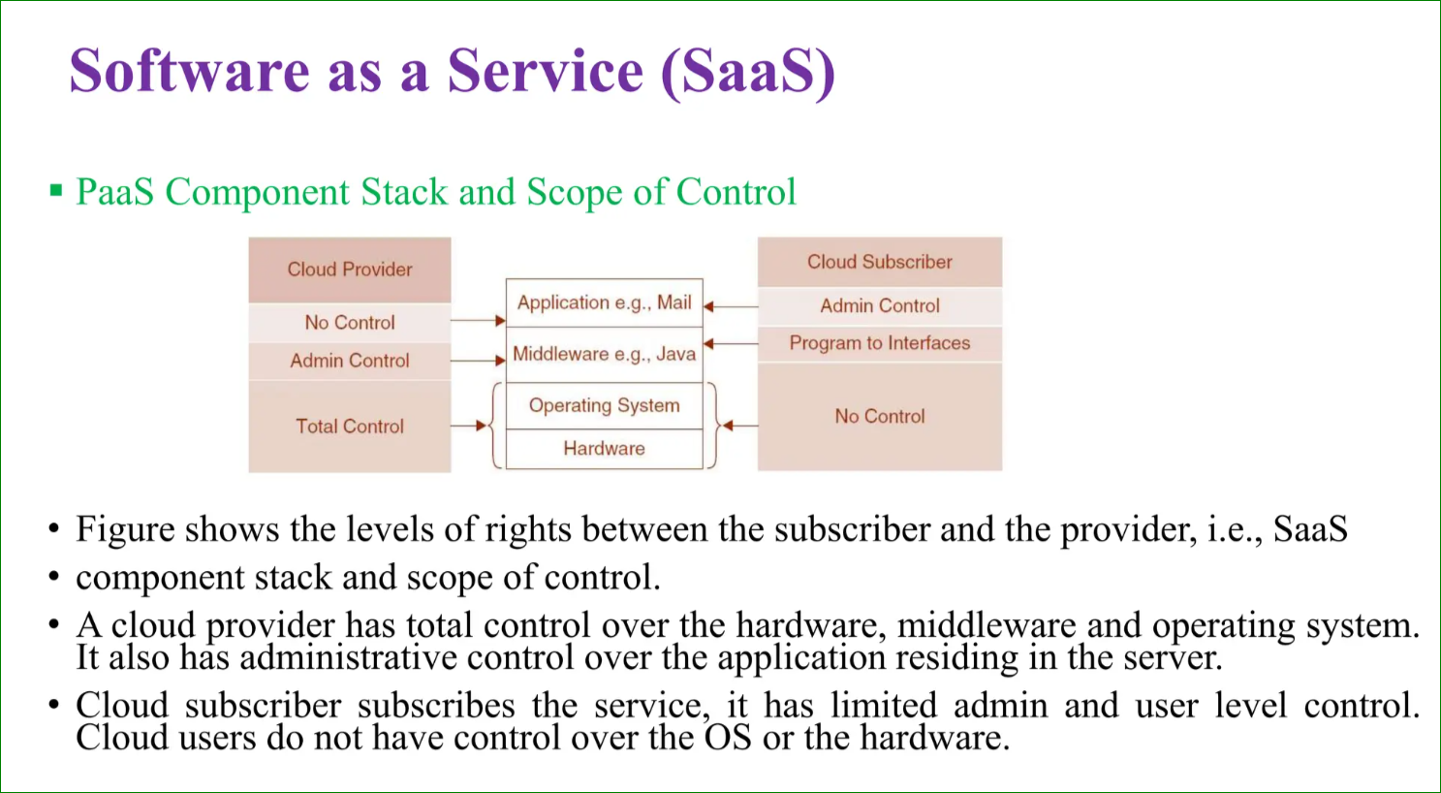
SaaS

Slide 29
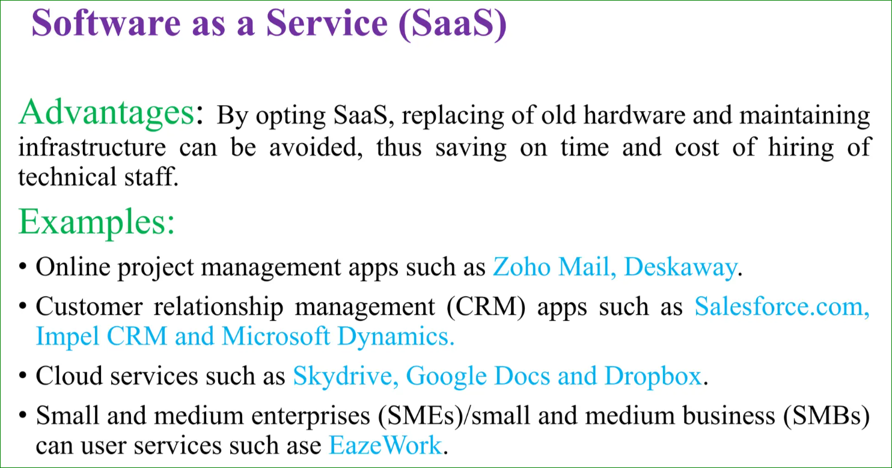

Slide 30
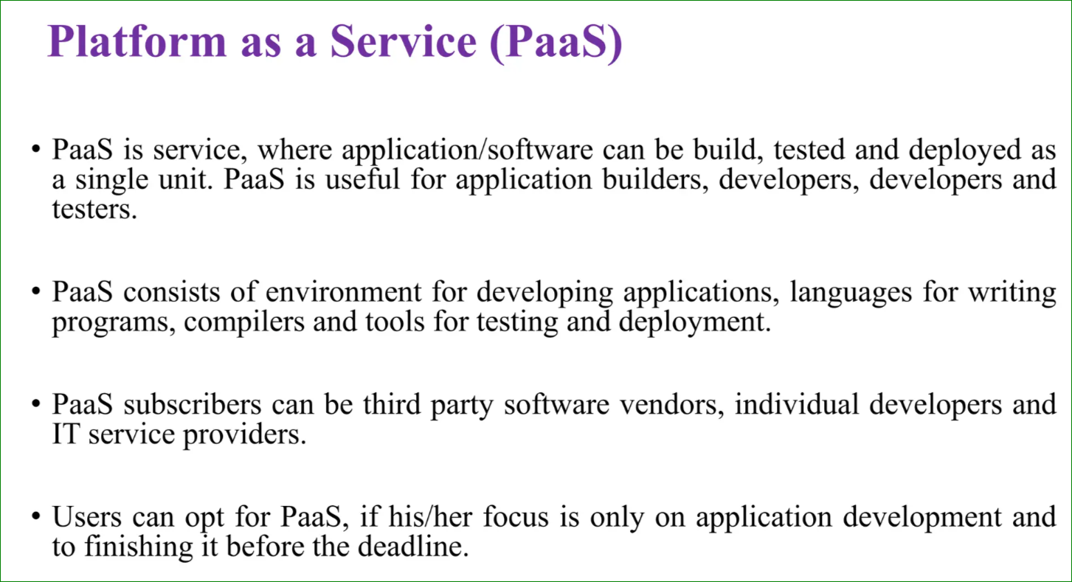

Slide 31
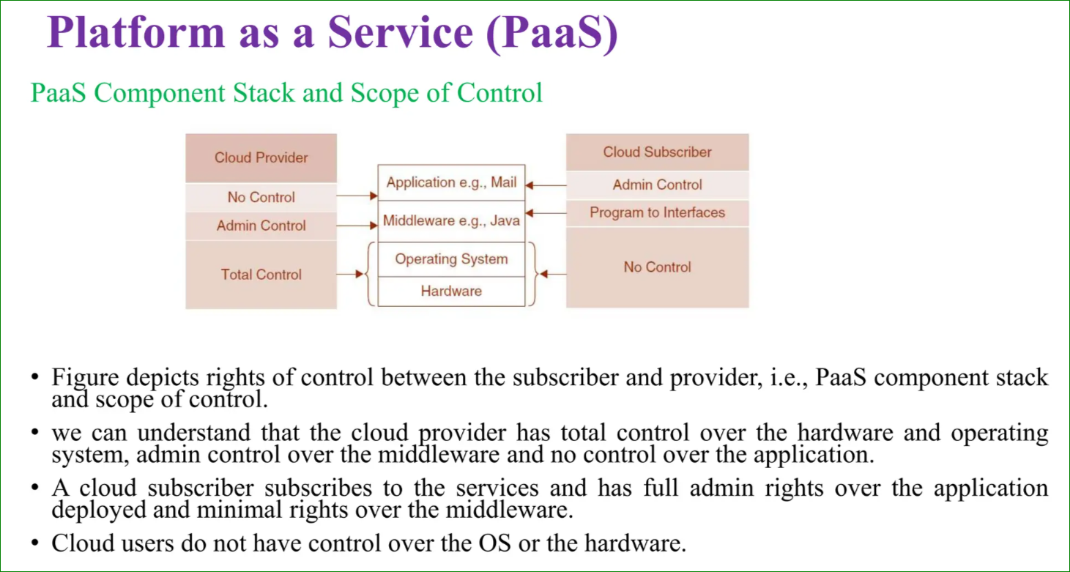

Slide 32
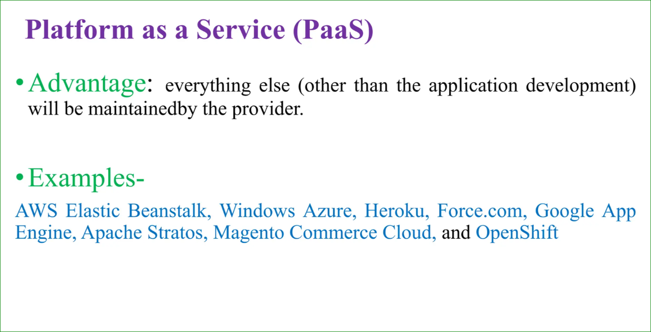

Slide 33
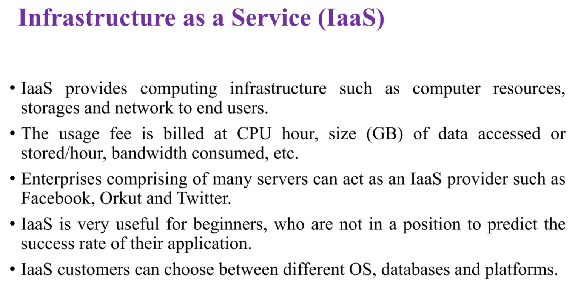

Slide 34
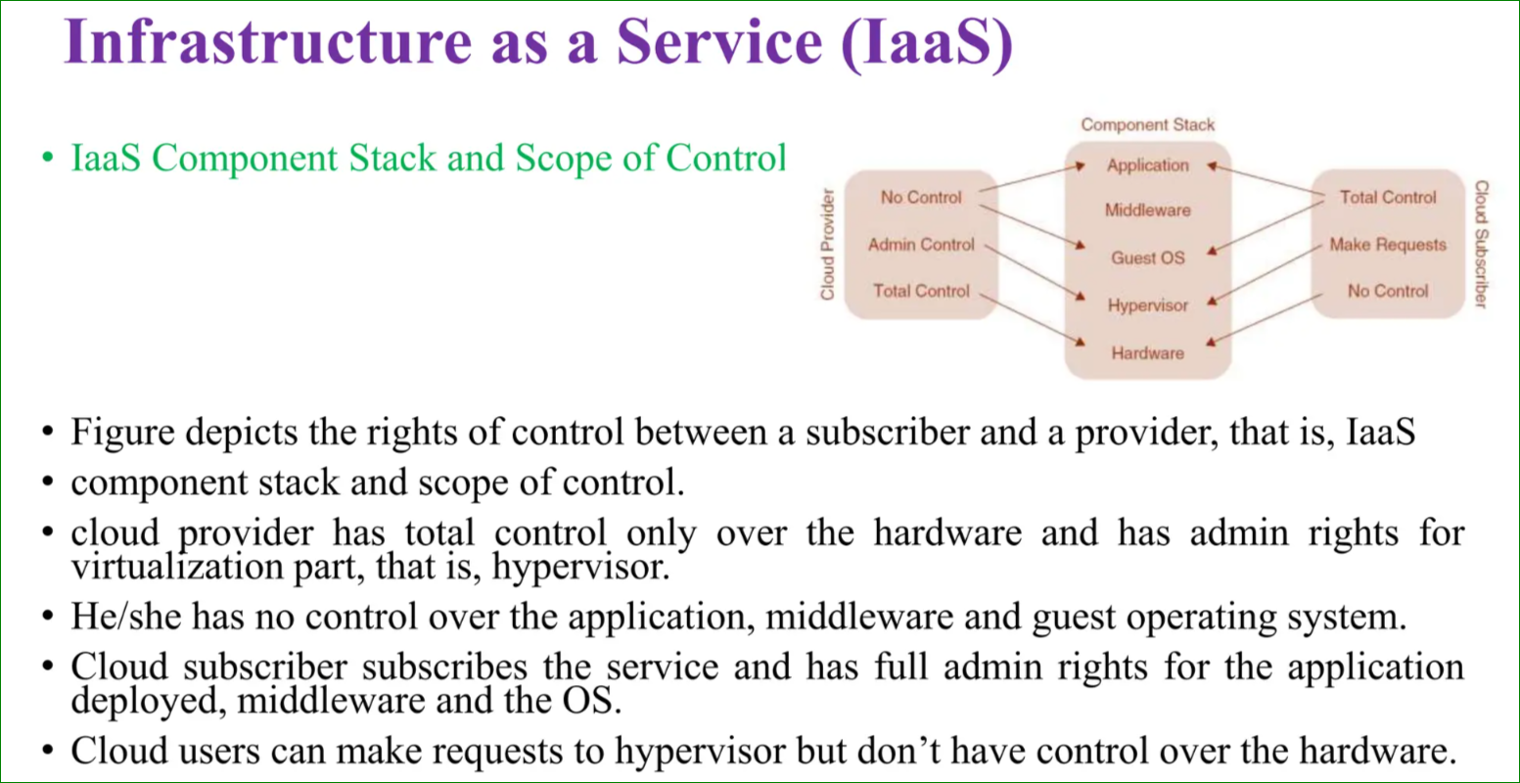

Slide 35
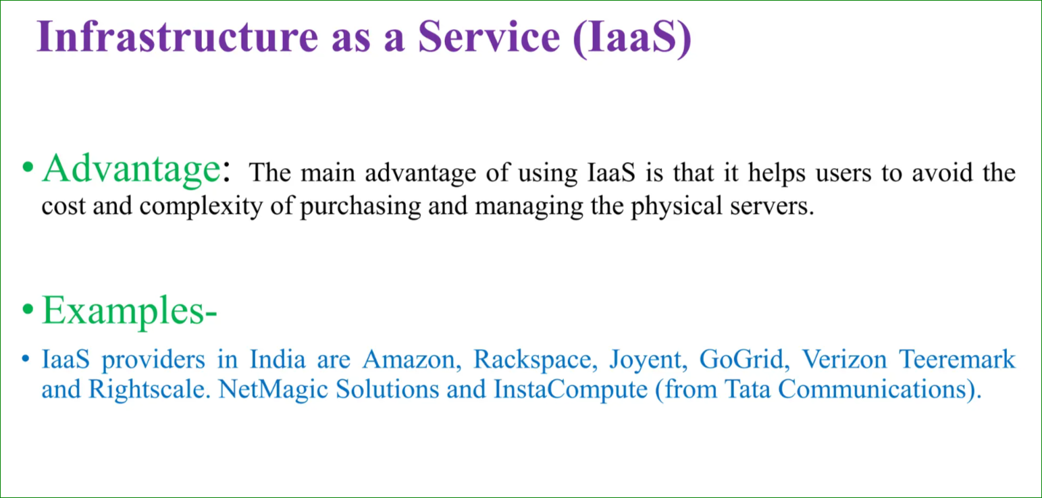

Slide 36
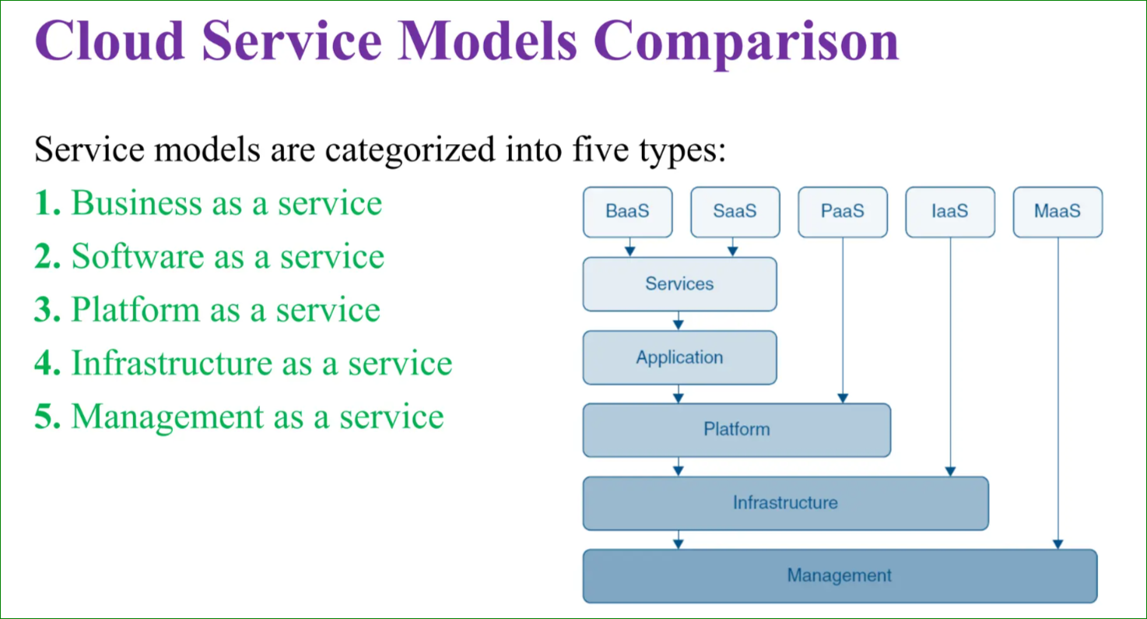

Slide 37
BaaS (Business as a Service)
BaaS (Business as a Service) in cloud computing refers to delivering business processes and services via the cloud. These services enable organizations to outsource entire business functions, allowing them to focus on their core competencies while leveraging the expertise and scalability of cloud providers.
Example:
A startup opts for Shopify to handle its online store operations, Salesforce for managing customer relationships, and QuickBooks for accounting. Instead of building these systems in-house, the startup uses BaaS providers to run the business efficiently.

Slide 38
MaaS (Management as a Service)
MaaS (Management as a Service) in cloud computing is a model that provides cloud-based tools and services for managing IT infrastructure, applications, and operations.
It enables organizations to outsource the management of their systems and resources to cloud providers, reducing the complexity of maintaining on-premises management solutions.
Example Use Case:
A company using a hybrid IT infrastructure (combination of on-premises servers and AWS cloud) deploys AWS Systems Manager. The MaaS tool helps the company manage configurations, monitor system performance, and automate patch management across its entire environment.
This streamlines operations, enhances efficiency, and minimizes downtime.

Slide 39
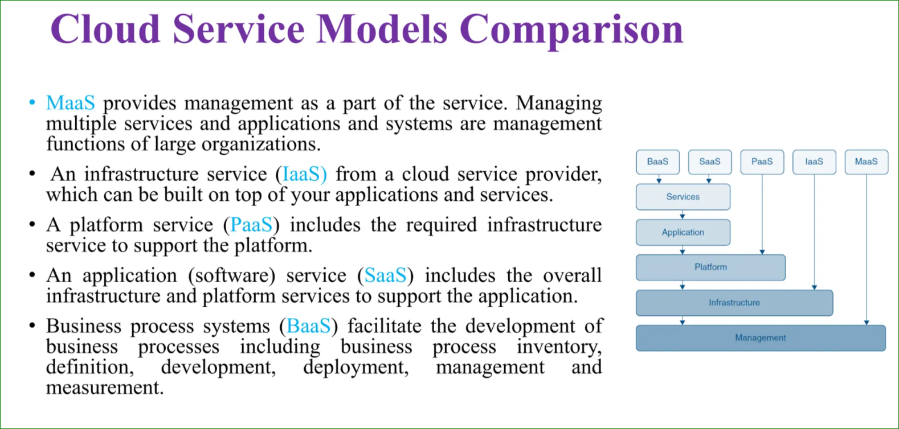

Slide 40
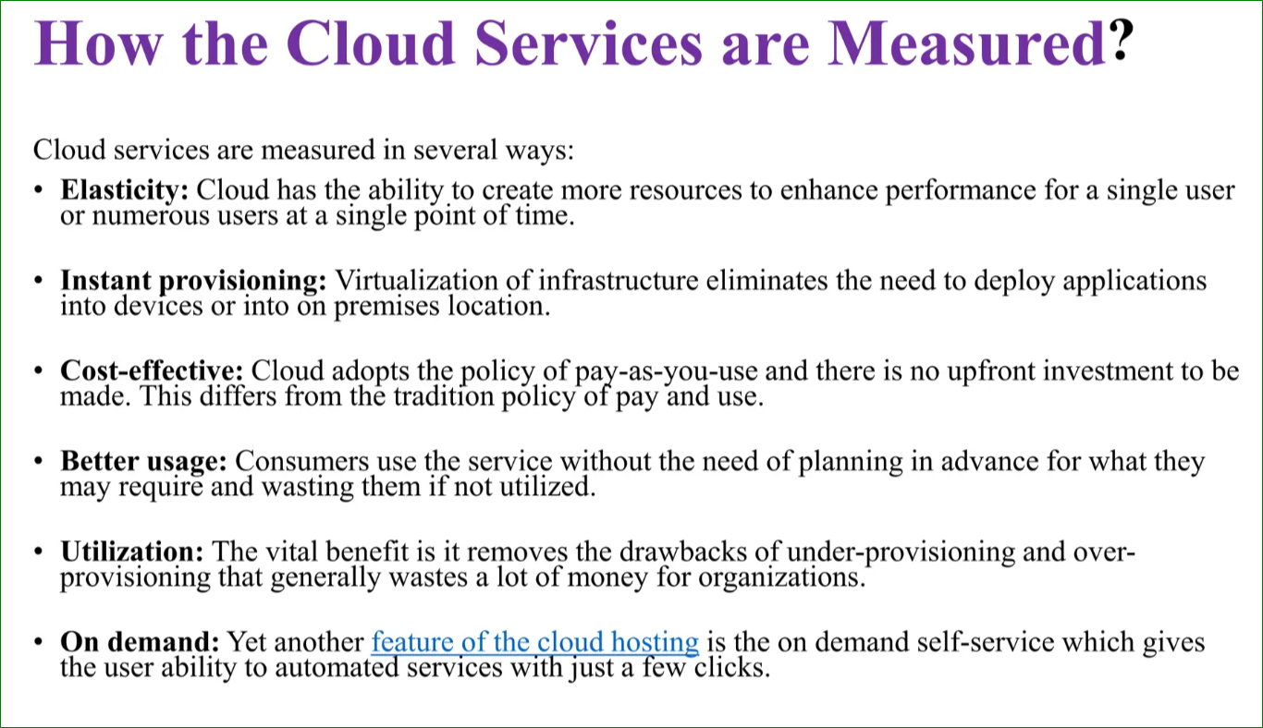

Slide 41
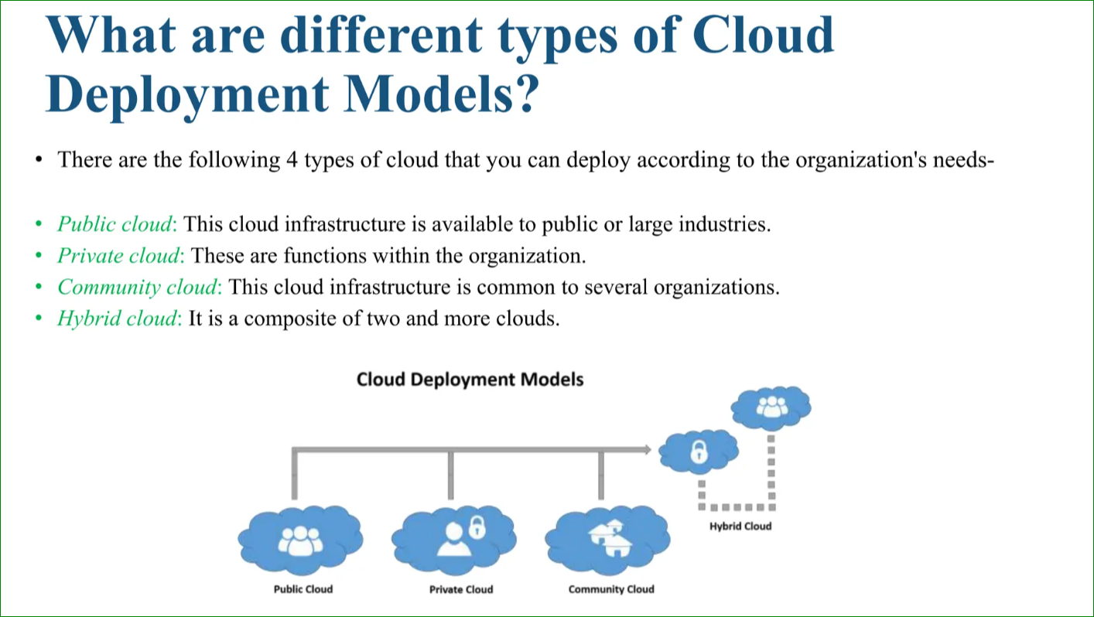

Slide 42
Deployment Models of Cloud Computing
1. Public Cloud:
- Services delivered over the internet, shared among users.
- Example: Small business using Dropbox.
2. Private Cloud:
- Dedicated to a single organization for better security.
- Example: Bank securing data with a private cloud.
3. Hybrid Cloud:
- Combines public and private clouds for flexibility.
- Example: Retail company using both public and private clouds.
4. Community Cloud:
- Shared infrastructure for common interests.
- Real-Life Example: Universities sharing research data.

Slide 43
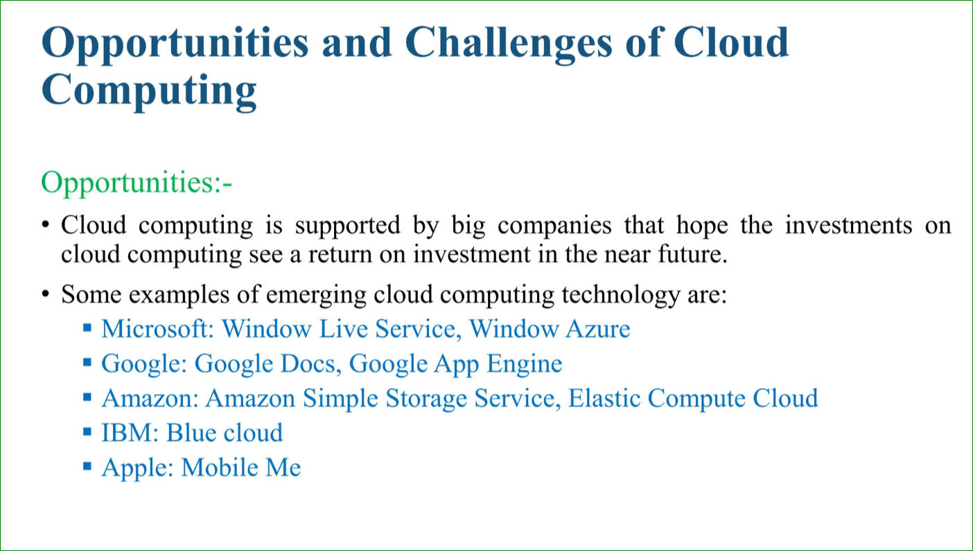

Slide 44
Benefits of Cloud Computing
1.Cost Savings: Pay only for resources used.
2.Scalability: Easily scale up or down based on needs.
3.Flexibility: Access services anytime, anywhere.
4.Security: Advanced security measures provided by cloud providers.
5.Efficiency: Reduce time managing IT infrastructure.

Slide 45
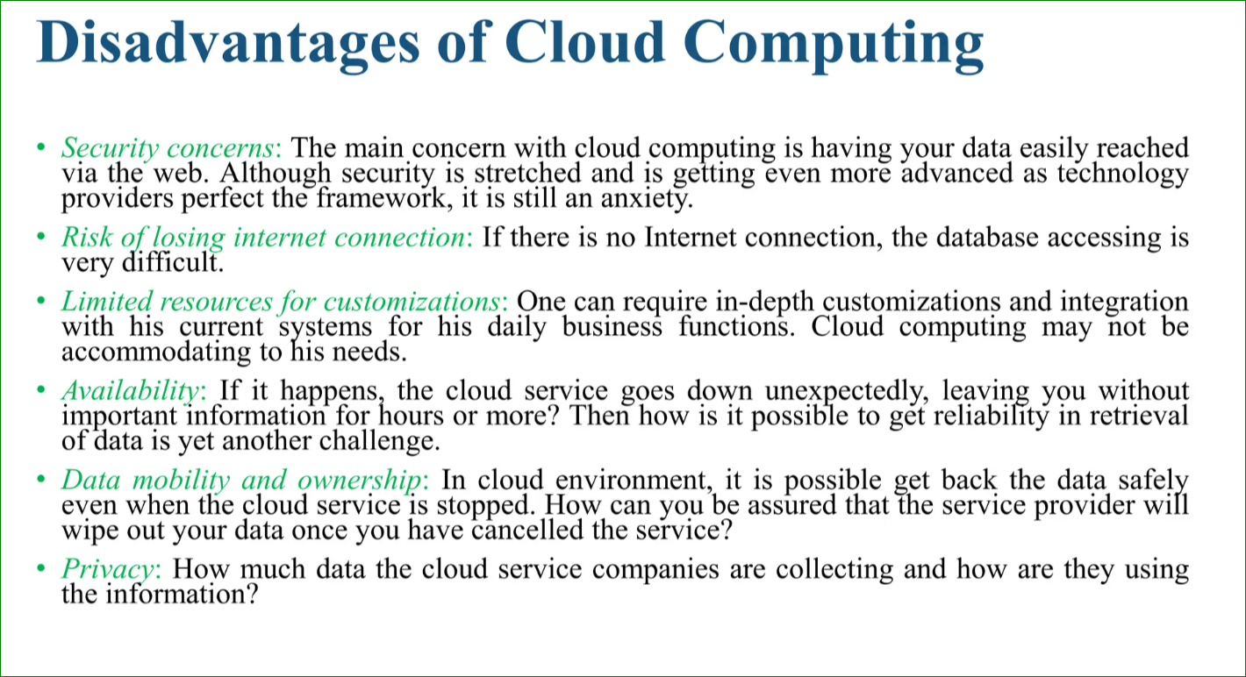

Slide 46
Conclusion
• Cloud computing has revolutionized industries by enabling businesses to innovate faster and reduce costs.
• Offers a variety of service and deployment models to suit diverse needs.
• Empowers businesses to focus on growth and innovation without worrying about IT infrastructure.

Slide 47
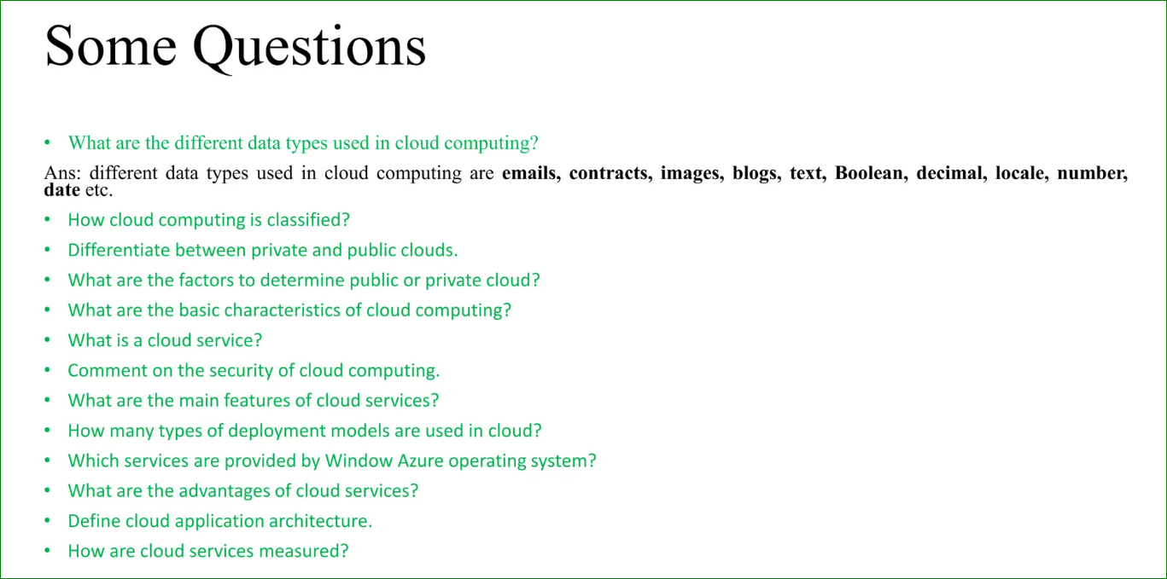

Slide 48
Questions & Discussion
Do you have any questions or examples you'd like to share?
Thank You!

Slide 49
Scenarios:
A mid-sized company needs to reduce IT costs while maintaining application performance. Which cloud service model would best suit their needs, and why?
(Hint: SaaS for applications or IaaS for infrastructure flexibility.)
2. A manufacturing company needs real-time data processing for IoT devices in remote locations. Which cloud service or approach would be most effective?
(Hint: Edge computing services like AWS IoT Greengrass or Azure IoT Edge.)

Slide 50
3. A game development studio needs high-performance computing resources to render graphics for its upcoming project. They want to scale down resources after completing the rendering phase.
Question: Which cloud service model is best suited for their needs, and why?
(Hint: IaaS)
4. A small startup is building a mobile app and wants to deploy it quickly without managing servers or worrying about scaling.
Question: How does PaaS simplify the app development process for this startup?

